Slide 1
System and Network Administration
Operating System Essentials

Slide 2
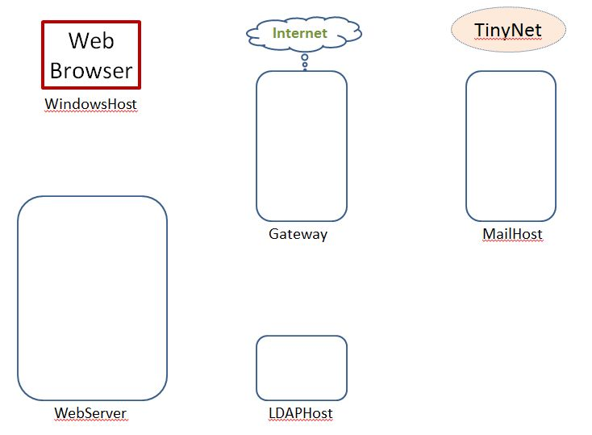
Getting Started
TinyNet
Comes in two parts
Base.iso (base image)
Config.iso (configuration and applications)
Create a virtual machine
Partition the disk
Create a filesystem
Copy the OS
Install the bootloader
Configure common services
Clone!
After installing VirtualBox, create VMs!
www.my-tiny.net

Slide 3




Slide 4
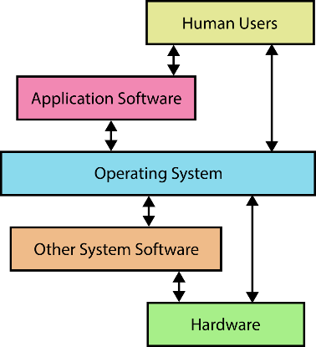
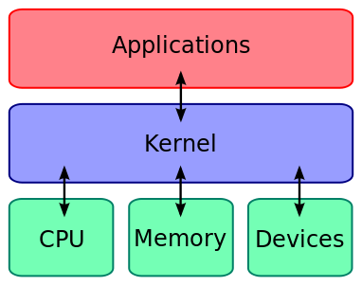
OS in detail
Device DriverSoftware

Slide 5
Services and Facilities
Command processor (shell)
I/O control system
Process control management and interprocess communication
Memory management
Storage management
File management
Network management, communication support, and communication interfaces
System protection management and security

Slide 6
Operating Systems
The operating system itself consists of hundreds or thousands of programs, each specialized for particular OS tasks.
Provides access to frequently needed facilities
Shields user from low-level details
but not system and network administrators!
User Interface: Command Line, Curses, GUI
The most complete administrative interface for Linux is the command line. GUI and Web based administration are possible, but don’t always offer the same number of configuration options.
Windows: powershell
Notes:
OS – software to share and control hardware resources of a device
HIDING complexity
Access via system calls
Hopefully STANDARDIZED system calls
POSIX is such a standard (Portable OS interface, IEEE)
Makes programming easier in terms of access to facilities
User interface developed historically via command line and graphical interfaces
First Windows offerings were an interesting stretch of the term “operating system”

Slide 7
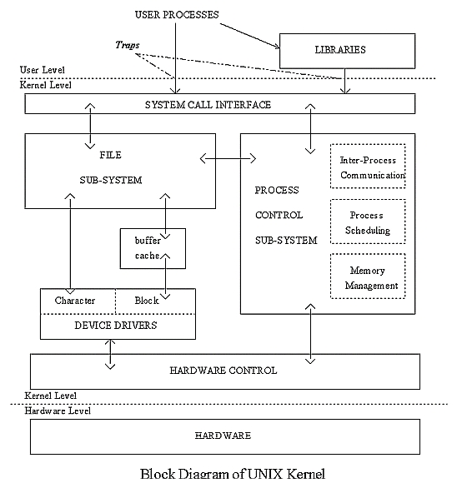
Operating Systems
Application programs: how to perform computing task
OS allocates access to the hardware (CPU, memory, etc.) and controls their use
Like a government, the OS performs no useful function by itself – it simply provides an environment for other programs to do useful work.
Processes/threads: logical concurrency
multi-user and event-driven
client/server architecture
Multi-core processors – real-time concurrency
Notes:
7
7
A lot of this is about HIDING hardware details
Hardware might change but interfaces should appear unchanged (standard)
The kernel is the core program of an operating system
Processes are programs in execution
Processes interact with the kernel via system calls
System libraries standardize how system calls are implemented
The kernel implements traps in order to react quickly to events
Traps and Interrupts are similar but distinct
Both are attempts to obtain attention from the CPU or the kernel
Traps are caused by software (hence, they are software interrupts)
Interrupts are caused by an external device, e.g., keyboard.
Being at the device level, interrupts are generally noted by the CPU

Slide 8
Device Drivers
In kernel space, the virtual file system (VFS) decodes the file type and transfers the file operations to the appropriate channel, like a filesystem module in case of a regular file or directory, or a device driver in case of a device file.
All of the functions used to access a specific device are jointly referred to as the device driver.
Device drivers must be statically compiled into the kernel or stored on disk as a dynamically loadable module.

Slide 9
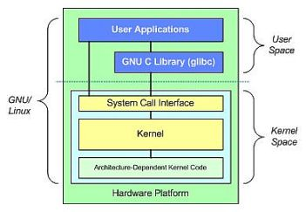
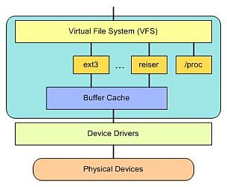

Slide 11
Processes
Each process is a collection of resources:
Instance of a running program in RAM, current directory, open files with current position, space and time limits, etc…
Processes are “time-sliced” by OS scheduler
Various policies and queues of waiting processes
A process may contain concurrent paths of execution called threads
To see the process hierarchy
Unix: ps or top
Windows: taskmanager
Shutdown terminates all processes
Notes:
Timeslicing as in round robin, as an illustration
Check out Task manager on windows or Top or ps on Unix
Processes have user and group IDs
The command ‘lsof’ in Unix is an important troubleshooting tool
Process trees are important for troubleshooting

Slide 12
Process Environment
Chains of processes share an environment
Environment is inherited by new processes.
changes made in local environment are not returned back to parent process environment.
Environment Variables
text strings
usually set by user or script
this is how command parameters are passed from parent to child.
Notes:
Environment variables make it easy to control program behavior
It all depends on what the processes start off with, inherited from parents
Try “set” in a Unix shell to see env vars

Slide 13
daemon
A daemon is a background process that performs a specific function or system related task. (in Windows, a “service”)
Started at boot time – runs as long as the system is up
or started and stopped as needed

Slide 15
Access Controls
Every process and every system resource has a single owner
Every owner has a unique User ID (UID) and belongs to one or more Groups identified by a Group ID (GID)
Unix groups are domains in Windows
The owner can give a a group privilege to access the resource. Anyone else is just the world at large.
Permissions limit reading, writing, execution
Superuser privileges override all explicit privileges
root (unix), Administrator (Windows)

Slide 16
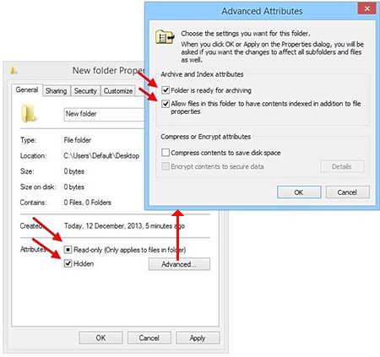
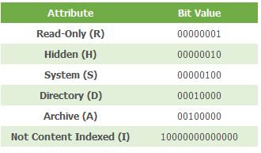
File permission

Slide 18
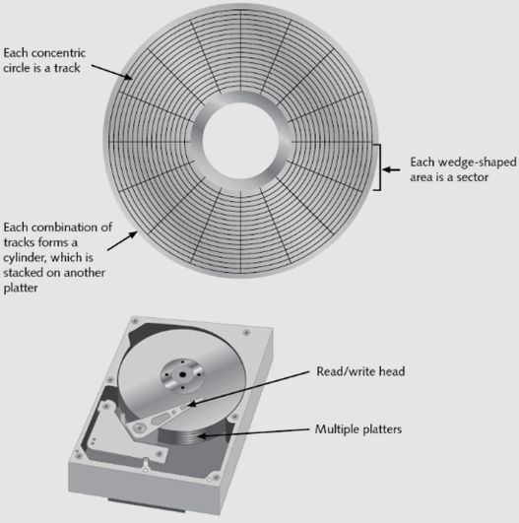
Hard Disk and Filesystem Fundamentals
Physical:
Track
Sector
Cylinder
Logical:
Partition
Cluster

Slide 19
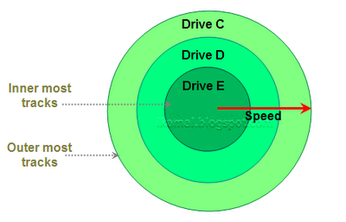
Disk Partition
A partition separates a disk into logical “drives”
A “DOS” (32-bit OS) partition can be one of two types:
Primary : can hold information regarding the operating system which is required for booting.
Extended: only for data files

Slide 20
Disk partitioning: fdisk
Reserve space for a particular function swap space, software, user directories, shares
Each partition is given a logical device name C:\ D:\ E:\ etc
/dev/sda1 /dev/dsk/c0t0d0s0
Each partition can use a different file system
Logical volumes seamlessly span multiple partitions
Use different partitions when
They have different functions
They are owned/maintained differently
They change at different rates
Backup policy is different for each
Notes:
Network Administration - Managing Hosts and Users
12-Aug-20
20
Swap space as a separate partition is fairly typical
Separate partitions for different groups of files makes sense
Some groups of files need frequent backups
Some groups of files rarely change, infrequent backups

Slide 21
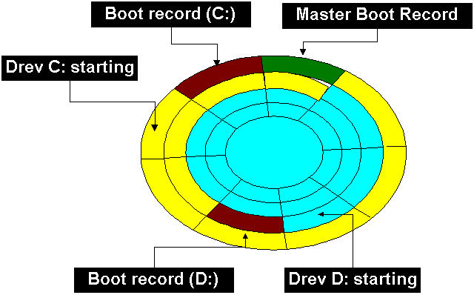
Master Boot Record
The master boot record (MBR) is the first sector of a hard disk
It includes a table that contains information about each partition
The diagram shows a disk with two primary partitions
The MBR also includes a program that reads the boot sector record of the partition containing the operating system into RAM.

Slide 22
Multiple Operating Systems – Boot Managers
With multi-use machines and big disks it is possible to have several different OSs
Each OS has its own boot manager in the MBR
Some are generalised, some not
For example, Windows relies on files accessed from drive C:
so install Windows first, then install Linux
Unix loaders:
LILO (LInux LOader),
syslinux (common for iso)
GRUB (GRand Unified Bootloader)
Notes:
Network Administration - Managing Hosts and Users
12-Aug-20
22
Virtualization, e.g., with VMware, negates the need for multiple boots in a host.
But virtualization is not perfect, e.g., compatibility issues, and taxes the hardware with multiple concurrently running Oss.

Slide 23
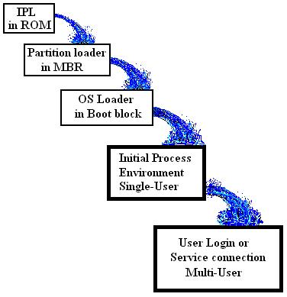
PC Bootstrap Sequence -- An Avalanche boot
BIOS IPL loads MBR
MBR selects active partition, loads partition boot
Partition boot loads OS loader
OS loader loads kernel
Kernel initialisation loads initial process
Initial process spawns user-level processes
IPL: Initial Program Loader
MBR: Master Boot Record
Notes:
Network Administration - Managing Hosts and Users
12-Aug-20
23
These details matter for fault isolation.

Slide 25
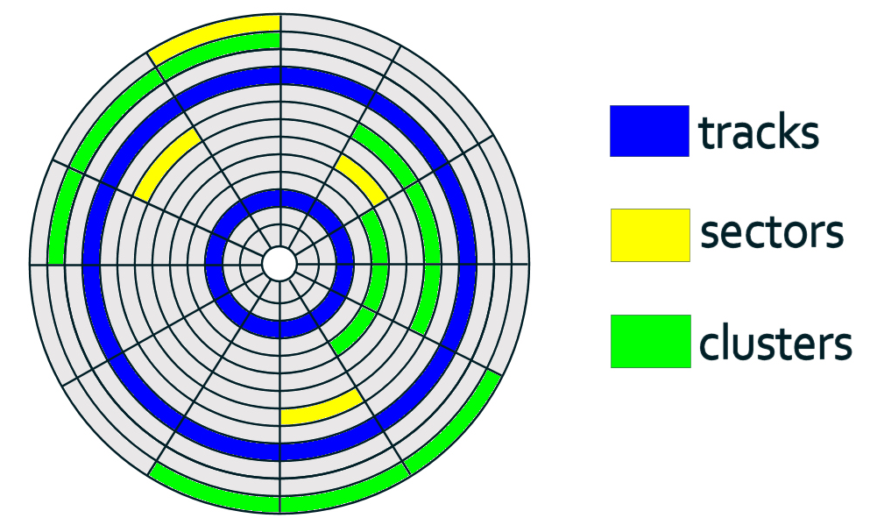
Cluster
A group of sectors is called a cluster.
The file system divides the storage on a disk volume into clusters for efficient disk usage and performance.

Slide 26
File Systems
Structures disk area for addressable access
“like painting car spaces in a carpark”
Usually unique to OS
windows: FAT, FAT32, NTFS
linux: ext2, ext4,
linux is one huge computer science project!
Physical sectors grouped into allocation units called blocks in Unix and clusters in Windows
Building File System - mkfs or format
boot sector, data area, free list
Notes:
Network Administration - Managing Hosts and Users
12-Aug-20
26
Mostly we only need to do
High level formas (like painting or repainting the lines in car spaces..)
Or zero-filling (scouring the carpark of any marking)
Low level format requires great accuracy, and so must be avoided
Some filesystem formats are interoperable, e.g., FAT32, ISO9660 (although the latter is not for hard disks)

Slide 27
Swap Space
Swapping frees RAM by storing an image of an idle process on disc - few modern OSs actually do swapping
The swap file is now used for paging – virtual memory stored on disc
In Unix the swap file is traditionally a partition
In Windows the swap file is always a file
Recommended size 2.5 * RAM
Any more will probably never be used
Notes:
Network Administration - Managing Hosts and Users
12-Aug-20
27

Slide 28
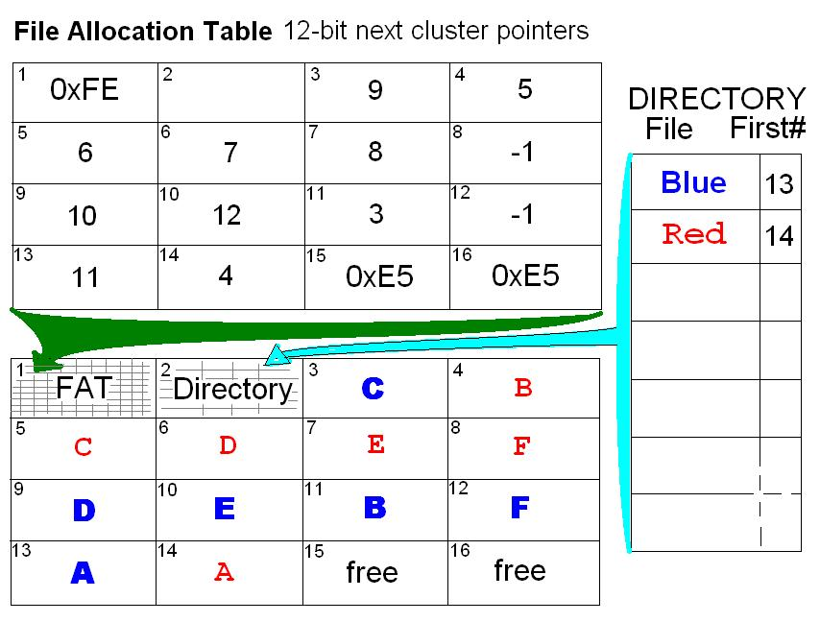
Example: MS-DOS File Allocation Table
Original FAT only allowed “8.3” filenames
Executable files recognised by .EXE, .COM, .BAT
FAT32 allows long filenames
NTFS - more efficient use of clusters
Unix filesystems use an analogous scheme of blocks with an inode table
Notes:
Network Administration - Managing Hosts and Users
12-Aug-20
28
Clusters belonging to the same file are linked as a chain of clusters.
Details in http://en.wikipedia.org/wiki/File_Allocation_Table

Slide 29
Windows file Systems
File system | Maximum filename length | MBR | Allowable characters in directory entries | Maximum pathname length | Maximum file size | Maximum volume size
NTFS | 255 characters | 0x07 | Depends on namespace used | 32,767 Unicode characters with each path up to 255 characters | 16 EB | 16 EB
FAT32 | 8.3 | 0x0B 0x0C | Any byte except values 0-31, 127 and: " * / : < > ? \ | + , . ; = [] (lowcase a-z are stored as A-Z). | No limit defined | 2 GB | 2 TB

Slide 30
Linux File Systems
File system | Maximum filename length | MBR | Allowable characters in directory entries | Maximum pathname length | Maximum file size | Maximum volume size
ext3 | 255 bytes | 0x83 | Any byte except NUL and / | No limit defined | 2 TB | 32 TB
ext4 | 255 bytes | 0x83 | Any byte except NUL and / | No limit defined | 16 TB | 1 EB
Most of the Linux is using ext* family

Slide 32
Mounting Disks / Partitions
Naming conventions for devices
Disk: /dev/sda /dev/sda1 … (usb will be recognised as this)
CD/USB: /dev/sr0 …
mount /dev/sda1 /mnt/sda1
access everything on the drive through the directory instructions in /etc/fstab
umount /mnt/hostshare
cannot unmount a busy filesystem
show open files on a filesystem: lsof

Slide 33
Paths
/ root directory . here .. up one level
/tmp/foo absolute tmp/foo relative ../../foo
cd change directory mv move or rename
cd /etc
cd foo
cd ..
mv foo ofo rename
mv ofo /var/opt move
cd /var/opt/ofo
./myscript.sh execute a file stored here

Slide 34
Symlink
Soft link or symbolic link (symlink): a small file that is a pointer to another file.
contains the path to the target file instead of a physical location on the hard disk; can point across partitions.
Note that removing the target file for a symbolic link makes the link useless.
Windows: shortcut (right click : file : properties)
used to create a new name to satisfy dependencies
a program that expects a file to be in another location
Symbolic links can generally save a lot of work

Slide 36
Shutdown
Complex systems need safe shutdown sequence to avoid damage
Quiescent state difficult to predict in multi-tasking systems
Complete all operations in progress
Prevent new operations from starting
Close files
Terminate processes and services
Synchronise and Flush buffers/caches
Dismount/park/eject disks
Power off !
Notes:
Network Administration - Managing Hosts and Users
12-Aug-20
36
Given that shutdown sequence processing is now mostly automatic, one thing remains to remember: DO NOT INTERRUPT THE SHUTDOWN SEQUENCE.

Slide 37
Caution!
Running VMs on a laptop:
Check your power settings – close lid, low battery, etc.
Never Hibernate, only Sleep
(“Hibernate” suspends too many host processes, and your VM will get corrupted – “Sleep” works well enough)
(or … just poweroff the VM)

Slide 39
Shared Libraries (.so) Dynamic Link Libraries (.dll)
Loaded into RAM on demand
Managed by some kernel routines which use an “index” to locate a required module
Special command used to do this – ldconfig
Must have the right libraries on your system
dependencies – missing or wrong version, cannot start
packages – bundle libraries, but often depend on others
package managers – help sort out dependencies
It is very likely that you will actually need to configure these, for one application or another
Notes:
Network Administration - Managing Hosts and Users
12-Aug-20
39

Slide 40
Source and Packages
A Linux distribution is a collection of utilities bundled around the Linux kernel.
Source code is the program in text file format, usually written in the language C
A binary file is the result of compiled source code.
A dependency is a component of the system that must already be installed before another program will function.
Some, but not all, compilation scripts will attempt a dependency check prior to installation.

Slide 41
Source and Packages
Packages are pre-configured binary files for specific distributions.
Usually a compressed archive:
.tar.gz .tgz .lzip .bzip .rpm .deb {.cab}
Package managers keep track of which packages have been installed, and perform a dependency check when you install software
Some distributions offer a tracking service that will notify you when new versions of installed packages are available.
Others automatically download packages from an official repository
Debian/Ubuntu
Local – dpkg
Auto – apt-get
RedHat
Local – rpm
Auto – yum
Slackware
Local – pkgtool
Auto – (none)
Celebrate
Diversity!

